Slide 1
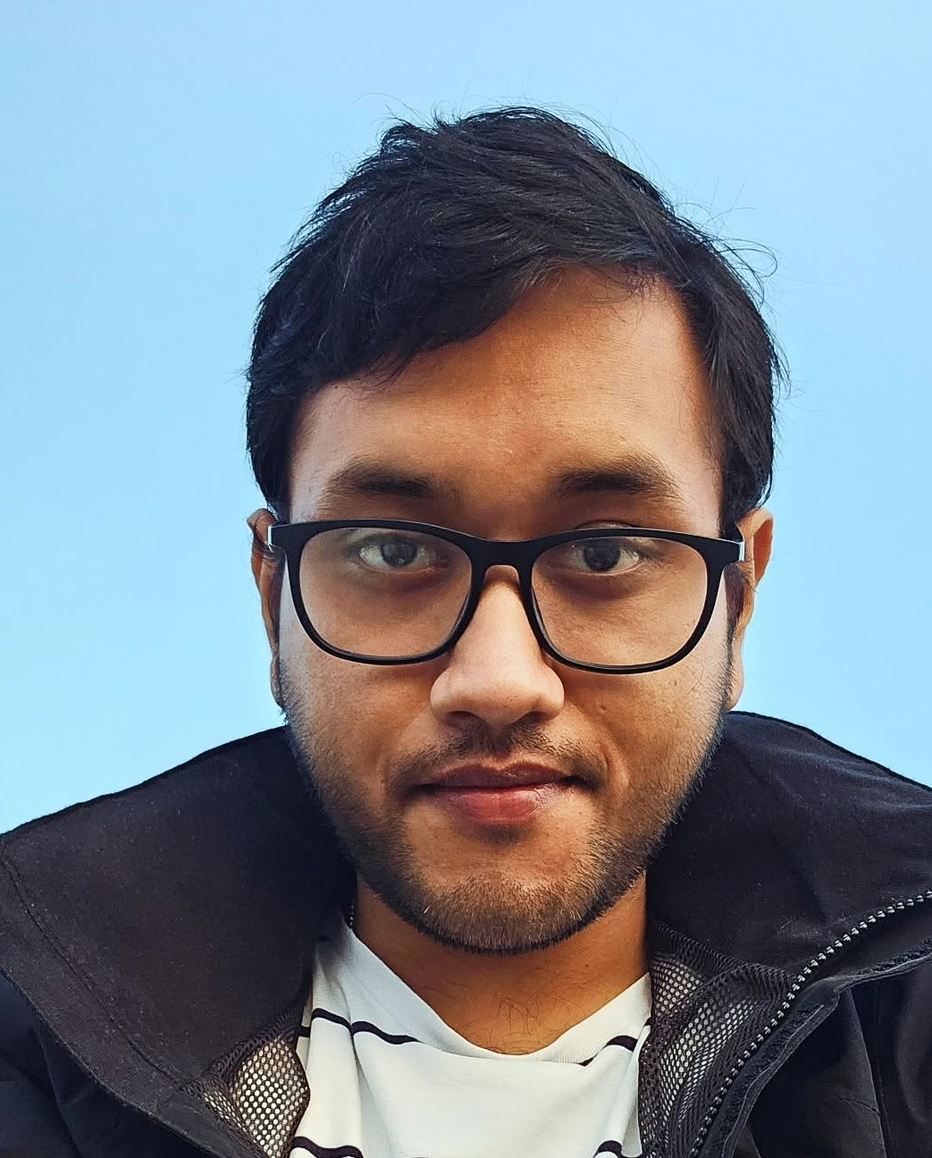
Hi, I'm Arunabha.
A mechanical engineer who paints. I build mechanisms with motors and sensors inside, and I sketch every idea on paper first.
From Agartala, Tripura (India) to Aalborg, Denmark. Now I'd love to build new play in Billund.
25%+
<10%
Best Paper
less motor energy in my
shoulder exoskeleton
error when estimating my
5-bar robot's stiffness
Award, IFToMM
ISRM 2026
Put one of your
sketches or paintings here
What I've built
Shoulder exoskeleton (PhD)
5-bar robot (PhD)
Soft exosuit (Master's)
Bachelor's builds
A spring mechanism, pretensioned by a worm gear, working with a 6 Nm motor. Optimised with a genetic algorithm, designed in SolidWorks, 3D printed, then manufactured. I integrated the motor, encoder and force sensors myself.
Designed and modelled a novel 5-bar parallel robot with variable stiffness mechanisms. Estimated its stiffness with less than 10% error and measured how stiff a human arm is (6 people).
Made silicone-based pneumatic muscles in a team of 4. Designed the outer PID loop, with anti-windup and error nonlinearisation, and ran it in LabVIEW.
An arm exoskeleton and exo glove with Arduino control (Best Major Project, TATA grant). Plus a Go-Kart and a hybrid Efficycle with student teams.
What I bring to Creative Play Lab: first-principles thinking (forces, energy, springs), fast making with SolidWorks, 3D printing, Arduino and sensors, workshop skills, and a Senior Diploma in Fine Arts with graphic design in Illustrator, Photoshop and Procreate.
Arunabha Majumder | somrkmv1997@gmail.com | 97arunabhasit027@gmail.com | +45 71 62 24 00 | arunabha22.github.io/arunabha-majumder

